Slide 1
Smartcity Concept: how’s UTI ready for it?
Adrian Florea,
ITS & Ticketing Business Unit Director

Slide 2
AGENDA
What is a SmartCity and why do we actually need it?
European Commission view on SmartCity
Smart-cities: European ranking
UTI’s vision on building SmartCities
UTI: “Ready for SmartCity solutions”

Slide 3
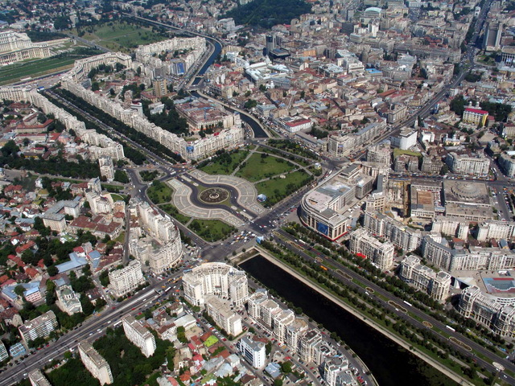
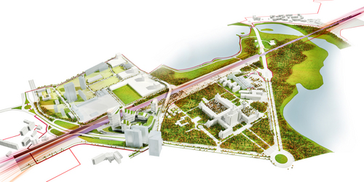

Why Smart Cities?
Cities are on a rise
  More and more people move to urban areas
  Increasing pressure on cities‘ infrastructure
  Over 50%¹ of world people are cities inhabitants, from 2008
  By 2050, 70% of world population will be city dwellers
¹ World Urbanization Prospects’ report
Urbanites grow²
  World population will surpass 9 billion by 2050 (8 by 2030)
  Urban dwellers will surpass 6 billion by 2050
  Two in three people born in the next 30 years will live in cities
² Romanian urban population share increased from 32% in 1960 to 55% in 2010
Quality of life
  Technology enhancements and access to information made citizens escalate the needs for smart cities, where innovation, technology, sustainability, citizen well-being and economic development integrate, aims to a better quality of life

Slide 4

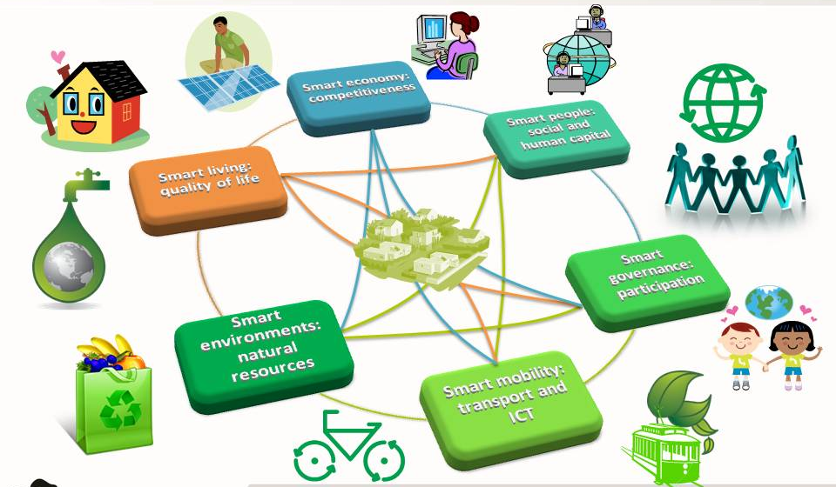
How’s EU looking at Smart Cities?
European Commission launched in July 2012 the “Smart Cities and Communities Innovation Partnership” (SCC), aiming to:
  boost the development of smart technologies¹ in cities
  demonstrate innovative urban solutions at the interface of energy, transport and ICT
Definition:
a city becomes “Smart” when investments into human and social capital, transportation (ITS) and communications infrastructure (ICT) powers in a sustainable manner the economical development and high quality of life with an intelligent management of natural resources.
¹ Innovative, Intelligent , Driven by Efficiency

Slide 5
How’s EU looking at Smart Cities? (cont.)
Smart Cities are categorized according to 6 different dimensions:
SMART ECONOMY –
Competitiveness
Innovative Spirit
SMART ENVIRONMENT –
Natural Resources
Amenity of natural conditions
SMART PEOPLE –
Social and Human Capital
Level of qualification
Social and ethnic plurality
Entrepreneurship
Image & trademarks
Productivity
International embedding
Ability of conversion
Pollution
Environmental protection
Sustainable resource management
Affinity to life-long learning
Flexibility and creativity
Cosmopolitanism
Participation in public life
Flexibility
SMART GOVERNANCE –
Participation
Participation in decision-making
SMART LIVING –
Quality of Life
Cultural facilities
SMART MOBILITY –
Transport and ICT
Local accessibility
Social cohesion
Public and social services
Transparency
Political strategies & perspectives
Health conditions
Individual safety
Housing quality
Education facilities
Touristic amenity
(Inter)national accessibility
Availability of ICT* infrastructure
Sustainable, innovative and safe transport systems
    * ICT – Information and Communication Technologies

Slide 6

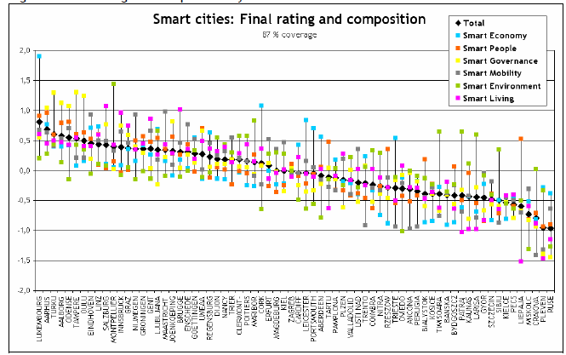
Smart Cities ranking
A study conducted by Wien University, TU Delft University and Ljubljana University, ranked European cities of 100 to 500.000 inhabitants, having at least 1 university, through the 6 smart-city dimensions.
Luxemburg # 1
Salzburg
# 10
Zagreb
# 35
Timisoara
# 55
Sibiu
# 63
Craiova
# 68

Slide 7
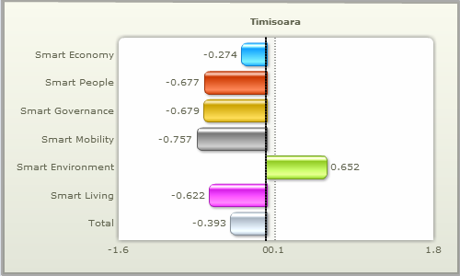
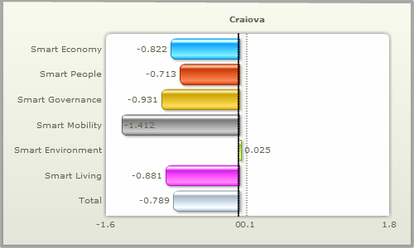

Smart Cities ranking: Romanian Cities
Romanian ranked cities scored similar in the Smart Mobility and Smart Living dimensions, both scores being driven by low mobility, low ICT and/or accessibility, housing quality, cultural facilities.
Low on
availability of ICT
Low on
Cultural Facilities
Housing quality
Low on
availability of ICT,
International accessibility
Low on
availability of ICT and accessibility
Low on
Housing quality,
Individual Safety
Low on
Housing quality

Slide 8
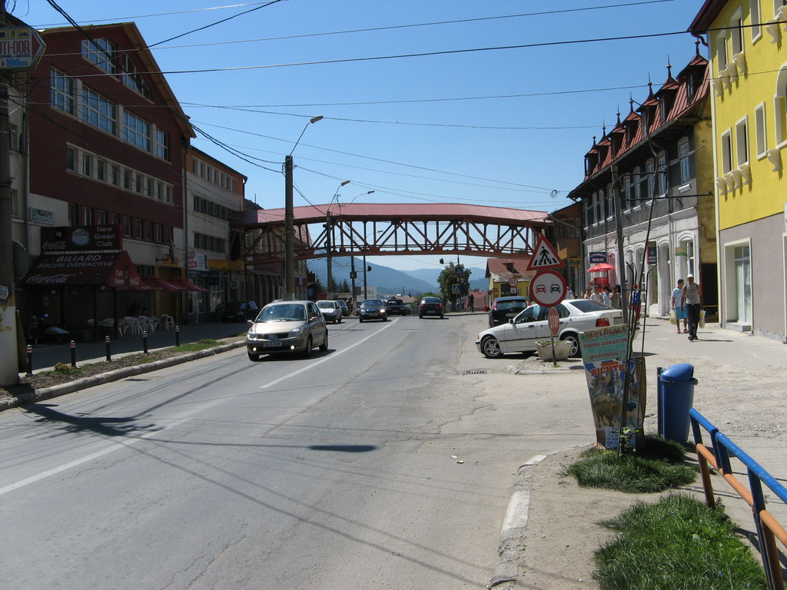
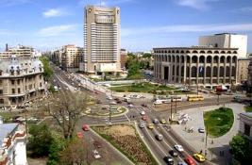
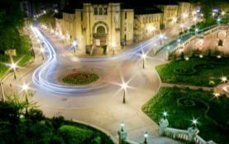
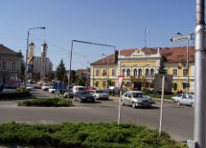
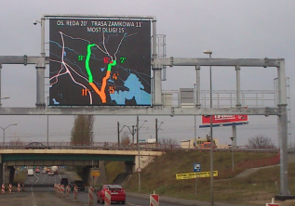
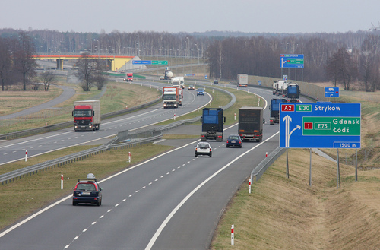
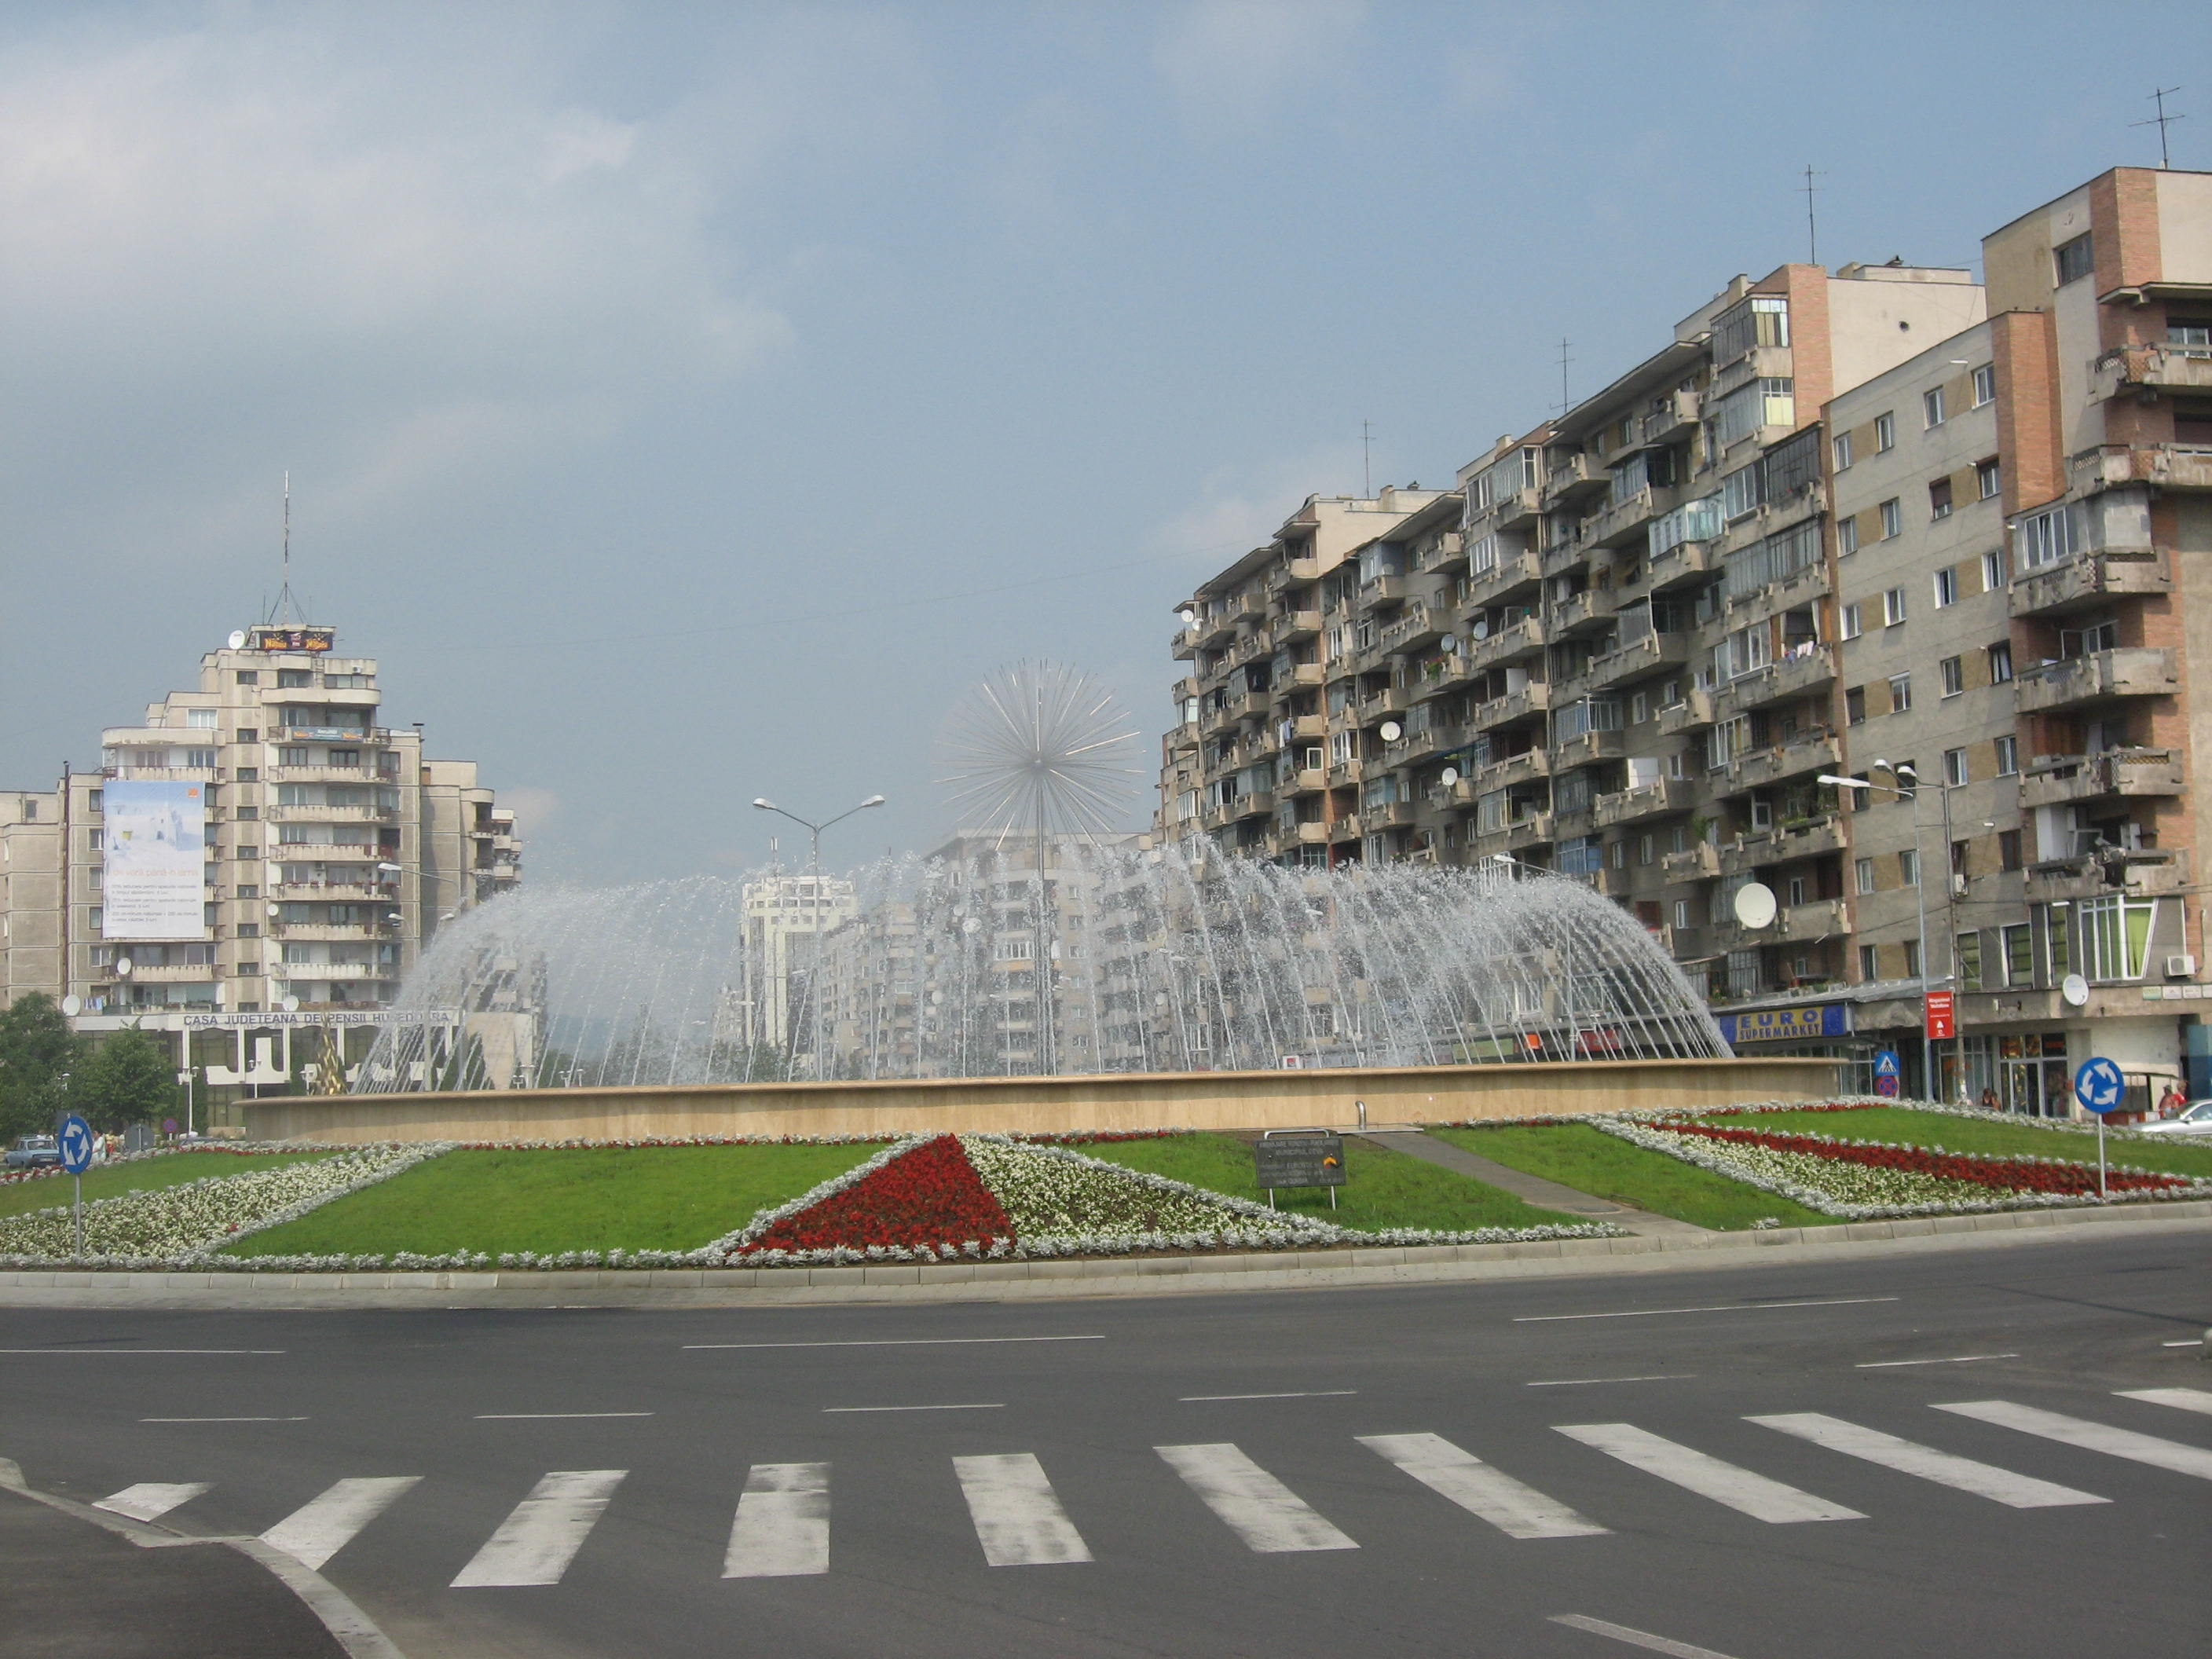
UTI: market leader in ITS* projects
Bucharest | Iasi | Zalau | Szczecin (Poland) | Other projects
2 mil. inhabitants | 300k inhabitants | 70k inhabitants | 410k inhabitants | From 40k inhabitants
1950 km of streets | 510 km of streets | 105 km of streets | 310 km of streets | From 50 km of streets
230 junctions 300 buses CCTV cameras Command Center | 15 junctions Public Transportation Prioritization | 11 junctions CCTV cameras Command Center Red Light Enforcement | 5 junctions CCTV cameras Variable Message Signs Command Center | 3 to 30 junctions In progress: Busteni, Deva, Ploiesti Finalized: Urziceni, Medias, A2
Size
    UTI successfully implemented 23 ITS* projects:
    For big-to-small cities
    With Adaptive traffic management solutions
    With Speed Enforcement solutions
    With Public Transportation Ticketing and Prioritization
    * Intelligent Transportation Systems, based on ICT
Our urban ITS solutions increase mobility for over 3 million inhabitants covering over 3,000 km of streets!

Slide 9
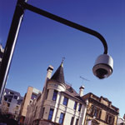



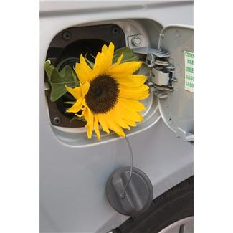

Building Smart Cities: our vision
Concept 1:
Smart House
FTTH
Fiber-to-the-Home
Public WiFi +
City Portal
Disaster Recovery & Back-Up
Smart Metering
Smart Grid
ICT network , optical fiber driven
Modernize Public transport, Traffic Mgm.
TV
Hot “plugs”
Info Kiosk/ Board
Enviro-ment, earthquake sensors
CCTV
Info from
Parkings
Concept 5:
SafeCity
Concept 4:
Connected City
Concept 2:
Informed City
Concept 3:
EcoCity

Slide 10
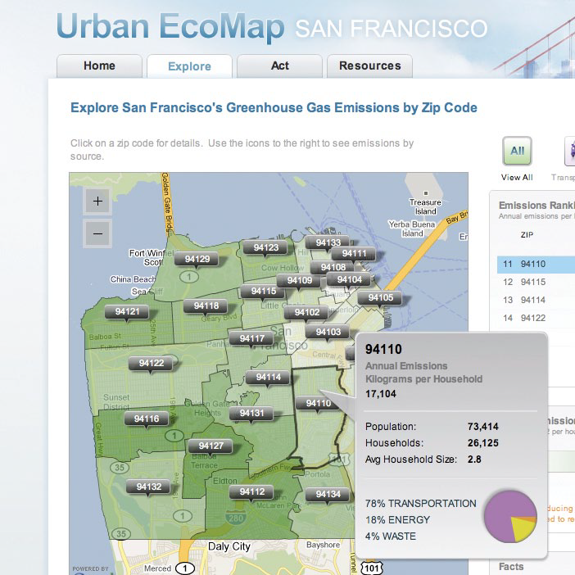
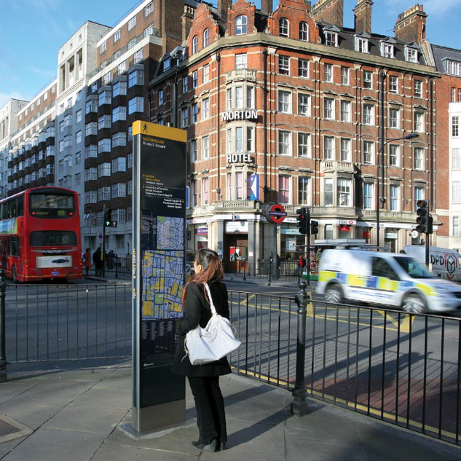
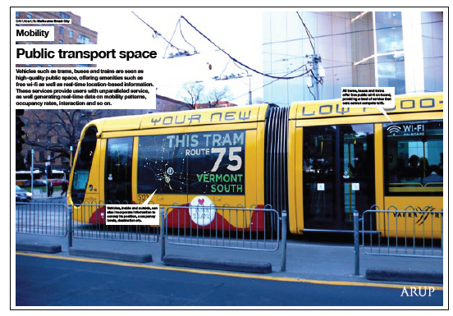
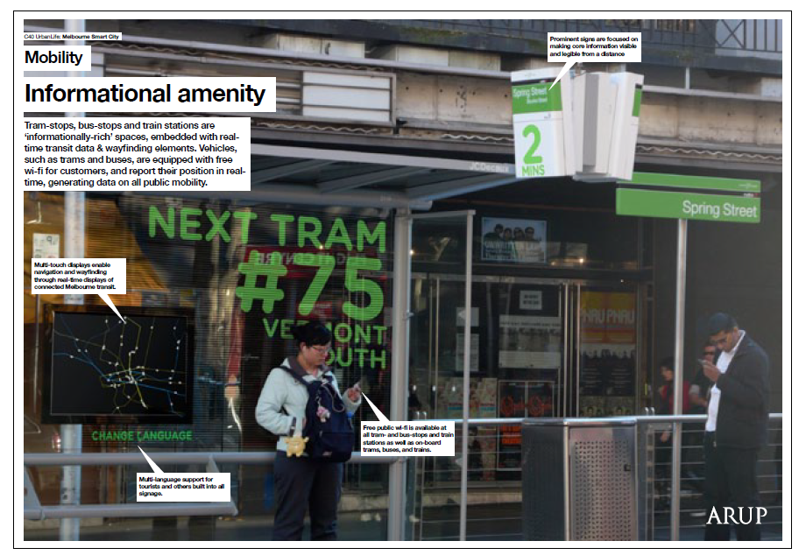

Smart Cities: examples
Citiy
San Francisco, Amsterdam
Environment sensors/
Portal
Our concepts
EcoCity
Connected City
City
Londra
Modernize public transport + InfoBoard
Our concepts
InformedCity
ConnectedCity
City
Melbourne
Modernize public transport WiFI/InfoBoard
Our concepts
InformedCity
ConnectedCity

Slide 11
UTI concepts. vs SmartCities dimensions
Dimension | Concepts of UTI vs. SmartCities dimensions
Smart Economy
Smart Environment
Smart People
Smart Governance
Smart Living
Smart Mobility
Productivity by ICT
Connected City
Protection – ITS, Sensors
EcoCity
Flexibility – ICT, PTE
Participation in public life – Portal /WiFi
Individual safety
ICT/ITS
Smart House
Housing – FTTH/Grid
SafeCity
Housing quality/ safety
Informed City

Slide 12
UTI concepts. vs SmartCities dimensions
Dimension | Concepts of UTI vs. SmartCities dimensions
Smart Economy
Smart Environment
Smart People
Smart Governance
Smart Living
Smart Mobility
Productivity by ICT
Connected City
Protection – ITS, Sensors
EcoCity
Flexibility – ICT, PTE
Participation in public life – Portal /WiFi
Individual safety
ICT/ITS
Smart House
Housing – FTTH/Grid
SafeCity
Housing quality/ safety
Informed City

Slide 13
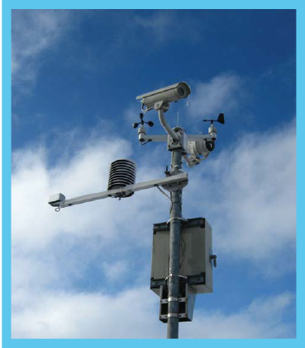
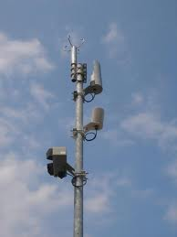
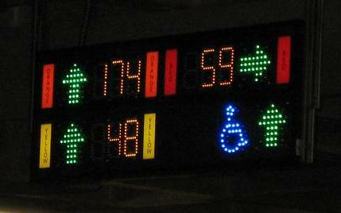
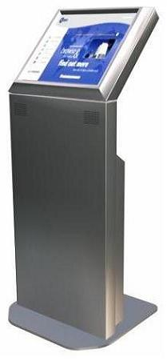
UTI existing products supporting SmartCities
FTTH
Fiber-to-the-Home
Public WiFi +
City Portal
Disaster Recovery & Back-Up
ICT network , optical fiber driven
Modernize Public transport, Traffic Mgm.
TV
Hot “plugs”
Info Kiosk/ Board
Enviro-ment, earthquake sensors
Smart Metering
Smart Grid
Info from
Park Places
CCTV
Existing
R&D
In progress

Slide 14
Smart-City concepts apply to small cities too
Small cities needs and issues
  Small cities like to further develop and go for modern solutions
  Today’s solutions generally require large hardware and software deployment
  Even if the technology costs are on a decreasing trend, implementing smart-city solutions implies significant budgets
Solution:
Go for Infrastructure-as-a-Service (IaaS) option
City-Hall / Local Authority | Partner
Develops system requirements Organizes tender (DBOT model) Signs-up for a long-term contract Pays a monthly fee for the used services Gets the infrastructure when contract ends | Designs and builds the infrastructure “Rents” the infrastructure as a service Gets a monthly fee Transfers the ownership when contract ends

Slide 15
Conclusions
Smart Cities
  The concept gained importance over the last years
  Aims at increasing citizens’ quality of life
  Improves the efficiency and quality of the services provided by governing bodies
  Citizens, companies and authorities are part of a city’s system
  This concept requires an integrated vision of a city and of its infrastructures
  ITS and ICT related solutions and applications lead the Smart City developments
  Smart City solutions are already available
Cooperation between the ITS and ICT industries, associated with the relevant sectors and public authorities should be stimulated to accelerate development of wide-scale roll out of Smart Cities.
UTI looks for partners for SmartCity full-scale and/or IaaS based solutions developments.

Slide 16
Thank you!
Adrian Florea,
ITS & Ticketing Business Unit Director
adrian.florea@uti.eu.com

