Slide 1
DIRECT ONE:
Delivering HD content over Internet
Catalin Clemente
Director, Marketing and Sales

Slide 2
OUR COMPANIES – Company PROFILE
Our companies are part of a Group with activities ranging from building infrastructure for telecom and energy sectors, electrical power production, natural gas and power distribution to telecommunications and new media integration
Energy, Telecom and Civil infrastructure construction, operations and maintenance Turn-key Contractor in Renewable Energy Project | Fiber Optic infrastructure engineering and operations Data carrier services provider, Content Delivery Network (CDN) Video Over-The-Top (OTT) Service provider | Supply and distribution of gas and electricity | Implementation and maintenance for wind-parks
Direct One figures for 2012: Revenues: 10.06 M Euro EBITDA: 4.89 M Euro No of Employees: 46 Audited by PWC
Group figures for 2012:
Revenues: 74.78 M Euro
EBITDA: 11.57 M Euro
No of Employees: 390
Audited by PWC

Slide 3
WHO WE ARE
Our edge servers are installed and connected in all major end-user networks, both national and international.
The first Romanian Content Delivery Network that can transport and deliver best quality multimedia content to anybody, anywhere.
Content Delivery Network
Connected to all major national and international networks
We own 53 telecom sites who function also as peering points for major national and international networks. More than 70 distribution nodes.
6000 km fiber optic infrastructure based on OPGW tech.
53 Sites with installed and connected servers.
We own and operate a 6000 km fiber optic infrastructure based on OPGW technology, the best technology in order to deliver the highest SLA.

Slide 4
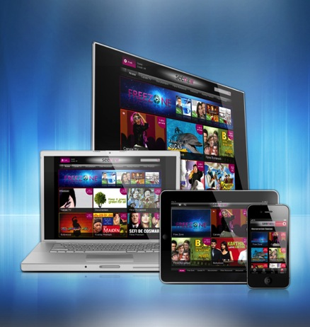
Today we want…
Watch what you want
Whenever you want
On any device
Learn and interact
Take control
Be totally mobile
A TV over Internet (OTT) solution seems to be right choice

Slide 5
PROS & CONS for an OTT solution
PROS
Ubiquity
Mobility
Multi screen integration
CONS
A wild, wild world
Traffic engineering?
Guaranteed quality of service?
Unlike broadcast the problems reach a new dimension once we discuss about high numbers of simultaneous sessions
Capacity rather than coverage

Slide 6
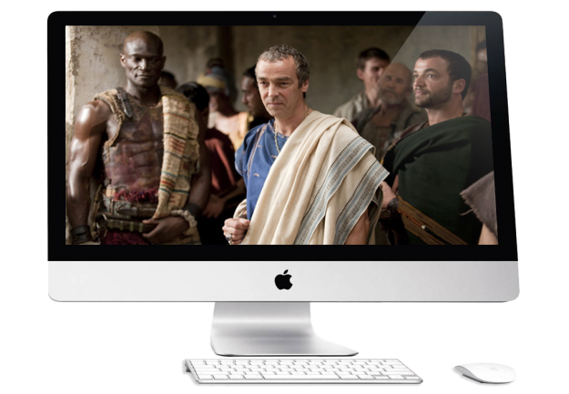
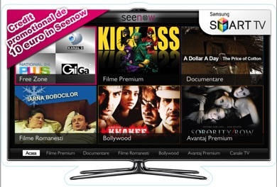
ENCODING PARAMETERS
Bandwidth consumption:
Mobile Stream
256 to 800 kbps
SD Video Stream
1,2 to 2 Mbps
480p Video Stream
1,2 to 2 Mbps
720p Video Stream
1,8 to 3 Mbps
900p Video Stream
2.4 to 4 Mbps
Best Picture quality at reasonable bandwidths!

Slide 7
TRAFFIC BEHAVIOR
Different pattern compared with an ISP’s or Carrier’s
This traffic has 2 components:
a predictable pattern – generated mainly by certain TV shows (live and recorded) and by the consumption habits ( in-the-office, at home).
an unpredictable component – generated by hot political agenda, unannounced political events, high-life events, football games, etc, and it can last for several tens of minutes, or hours.
There is no month similar with another one
A different type of event engage different type of viewers

Slide 8
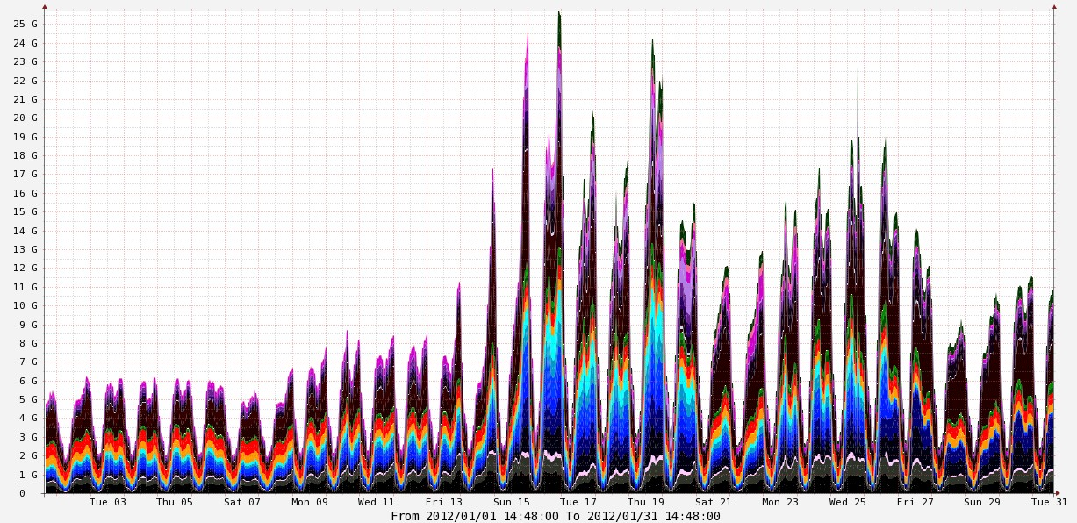
TRAFFIC BEHAVIOR
Street demonstrations against government
Street demonstrations
... continue
January 2012

Slide 9
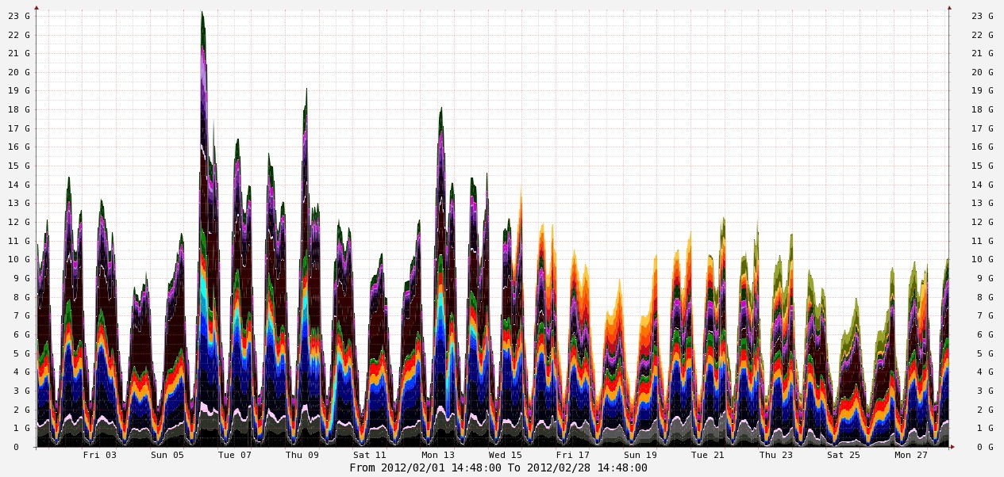
TRAFFIC BEHAVIOR
Discourse of
the president
and
government resignation
New government
invested
Weather
Red code
February 2012

Slide 10
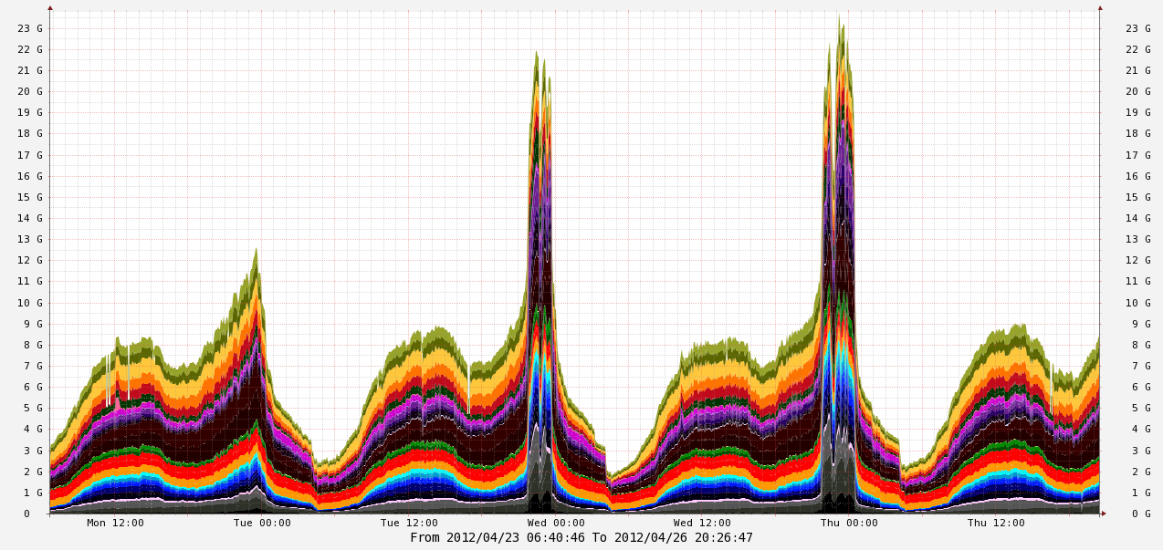
TRAFFIC BEHAVIOR
… a closer look– 24,25,26 April
UEFA Champions
League
Barcelona - Chelsea
UEFA Champions
League
Real - Bayern

Slide 11
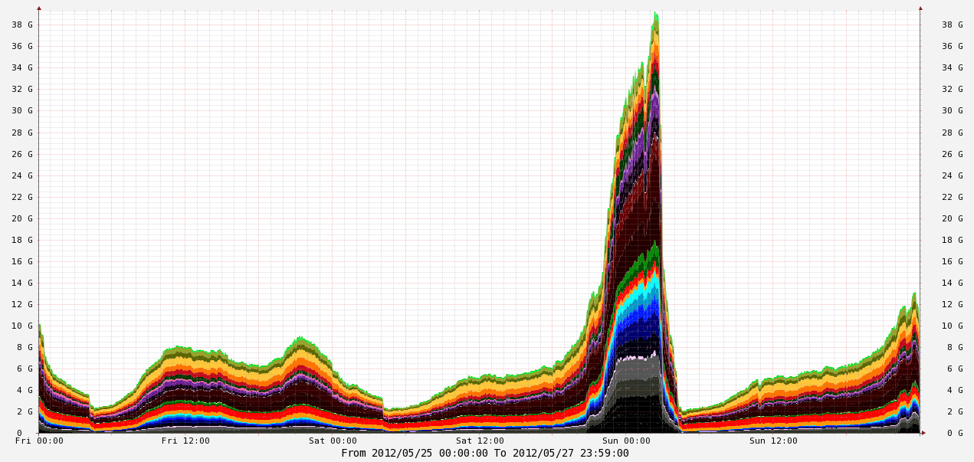
TRAFFIC BEHAVIOR
… another closer look - 26 may
Eurovision
+
Box match
IBF belt

Slide 12
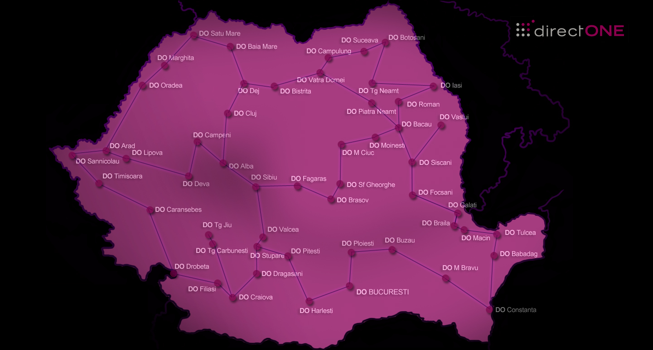
THE INFRASTRUCTURE
Streaming servers are present within our network in several locations to serve the regional areas

Slide 13
DIRECT ONE OTT PLATFORM:
An “End-to-End” Solution
Streaming Services
Content Services
User Access Interface
Video streaming
Live TV
Live Events
Video on Demand
Distribution on multiple platforms:
Web
PC Tablets
Smart Phones
Connected Devices (Smart TV)
Design and Implementations for:
Web
Web-sites
Media Centers
Video Portals
Mobile
PC Tablet
Connected devices
Content Aggregation
Content Processing
Ingest
Encoding
Subtitling Processing
Content Storage
Content Management
Library Administration
Programming
Packaging
Content Security
DRM
Geo-Protection
Payment &Billing
Analytics
Several payment methods for different needs
Possibility of integration with third-party service providers
Possibility of integration with partner BSS
Traffic Reports
Ad-delivery Reports
Financial Reports
Content Reports

Slide 14
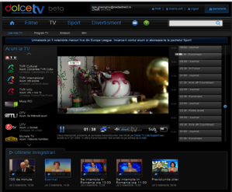
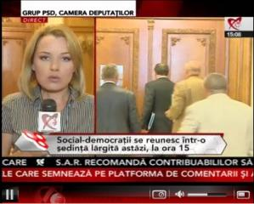
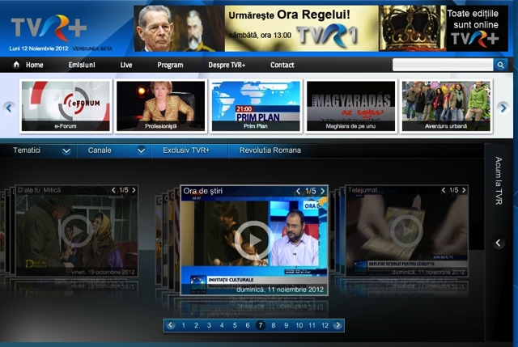
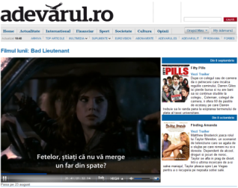
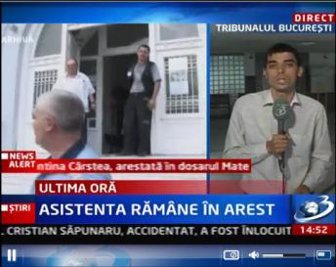
DIRECT ONE – THE OTT PLATFORM
Romtelecom’s and Cosmote’s Video Entertainment Portal | Romanian National Television’s (TVR) Video Portal | Live TV streaming for Romanian Publishers
Turn key Video web Portal and mobile Apps for Android and iOS | Video web portal launched in June 2012 Audience record of 32k simultaneous visitors during France-England football match (Euro 2012) | Video Content Management for Live and On Demand (Catch-up TV) More than 40Gbps bandwidth during important live events

Slide 15
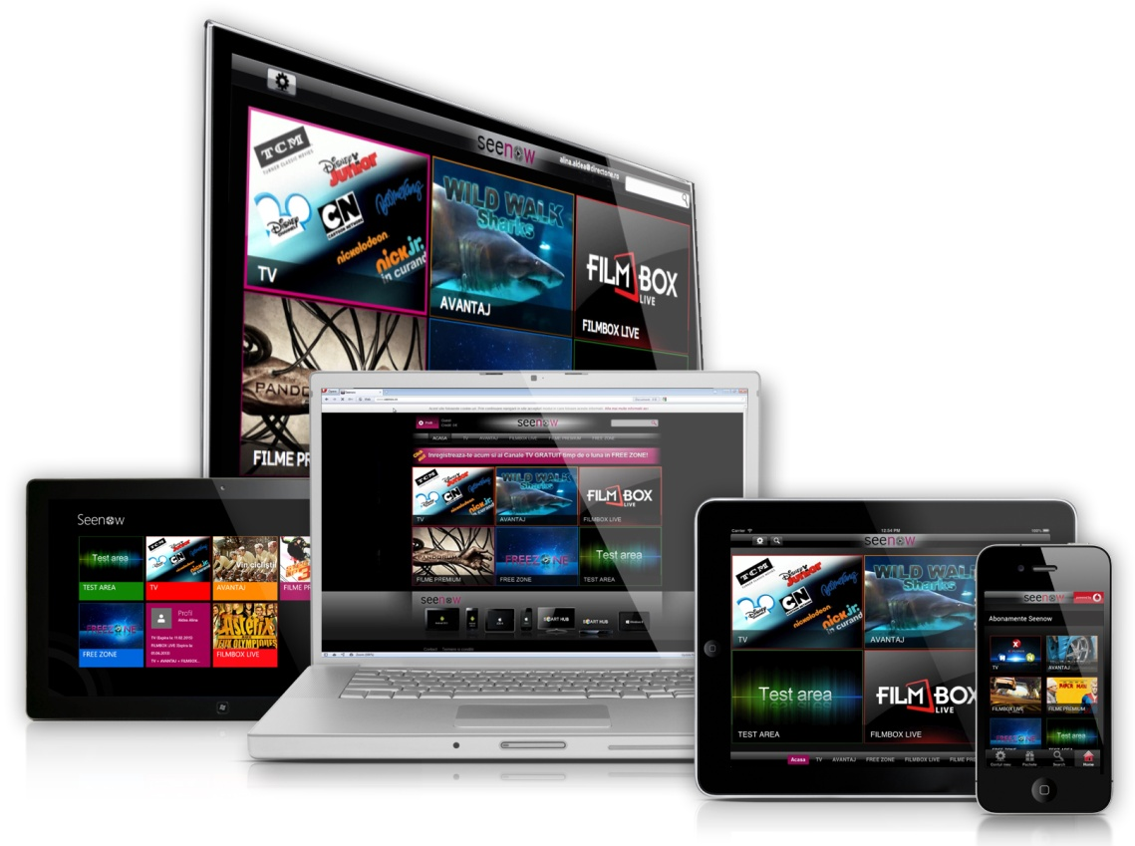
SEENOW: MULTI-SCREEN TV & VOD
First Live TV & VOD service in Romania (launched in December 2009)
Rebranded as Seenow and first mobile service since December 2011
Available on:
Smartphones, Android, IOS, Windows 8
PC Tablets: Android, IOS, Windows 8
Web: www.seenow.ro
Connected TVs: Samsung, LG (coming soon)
68 Live TV Channels
2700+ VOD titles
Hundreds of hours on Catch UP

Slide 16
SEENOW ECOSYSTEM
Direct One Technology & CDN
Mobile device manufacturers
Telecom Operators
Content Owners

Slide 17
SAMSUNG -THE DEVICE MANUFACTURER
Samsung offers..
Free content package
Communication
Pre-installation
Samsung gets..
A market differentiator
Promotion of new device
capacities and functions
A richer user experience

Slide 18
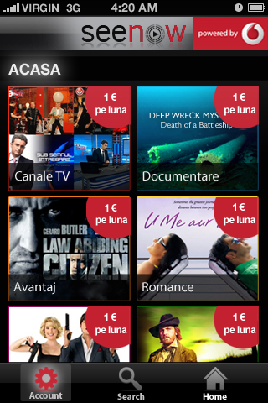
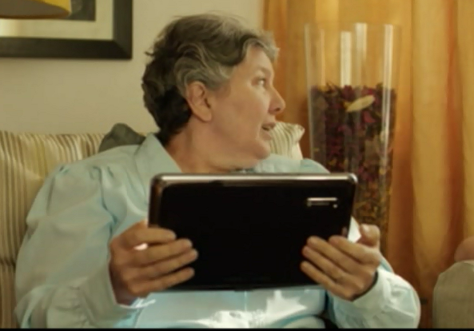
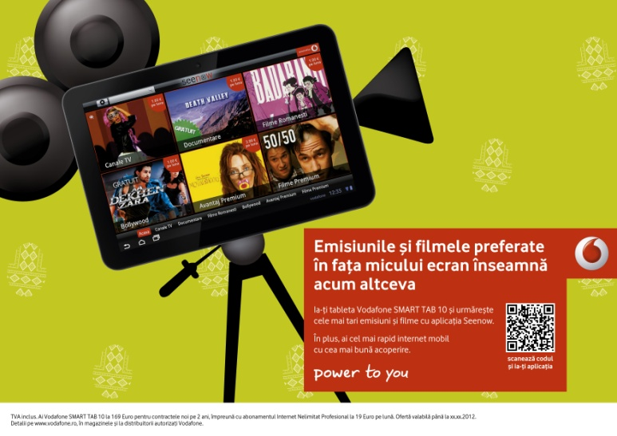
SEENOW AND VODAFONE
Vodafone gets..
A market differentiator
An OTT content offer
A richer mobile user experience
Vodafone offers..
Free 3G data traffic
Communication
Pre-installation

Slide 19
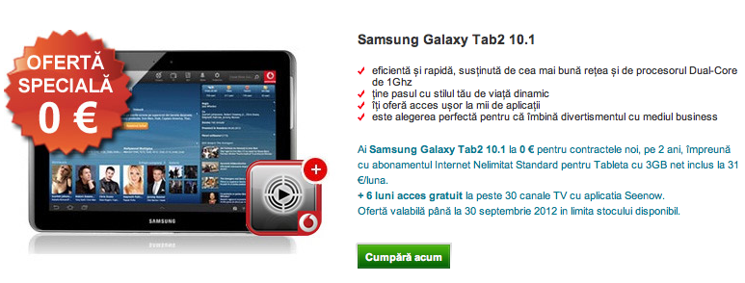
SEENOW, VODAFONE AND SAMSUNG
In Seenow, users get free TV content from Samsung and free data traffic from Vodafone!

Slide 20
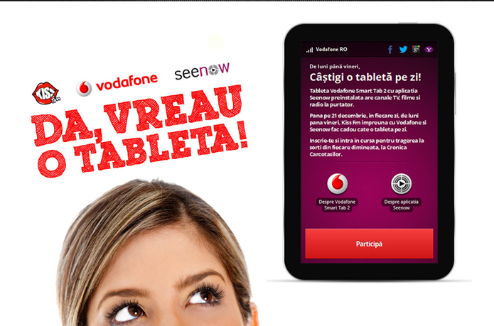
SEENOW, VODAFONE AND KISS-FM
Innovative and successful communication campaigns

Slide 21
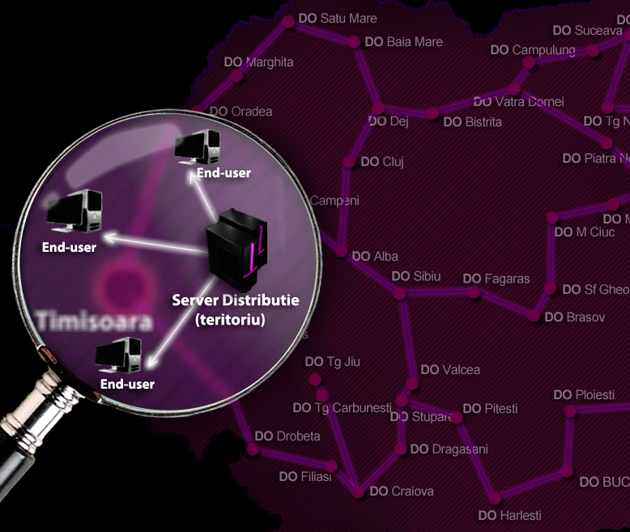
DIRECT ONE – THE ENABLER
Content aggregation
Content management
Video distribution
Business support system
Service and Apps
Analytics
Mobile Operatos

Slide 22
But even better than the story..
Thank you!
www.seenow.ro

